Slide 1


HCI Research
Craigslist Case Study
Analyzing design improvements
https://craigslist.org
PRESENTED BY
  seif mohamed ahamed dabour
  Khaled fawzy Mahmoud El-Gazzar
  Abdul Rahman Al-Sayed Raslan
  Eslam Osama Ebrahim Elfadaly
  Omar Mohamed Mansour Wahdan
  Abdelrahman Bder Abdelmotalleb Mohamed Al-Belehe
  Abdelrahman Aiman Abdelglil Mostafa Elbarawy

Slide 2

Human–Computer Interaction
Human–Computer Interaction (HCI) is the study of how users interact with computer systems, focusing on enhancing usability and user experience by minimizing effort and errors.

Slide 3
About Craigslist Cairo
LOCAL VERSION
ONLINE PLATFORM
Craigslist Cairo serves as the Egyptian local version of Craigslist for users.
This platform provides a local online classifieds service for people in Egypt.
BUYING & SELLING
JOBS & HOUSING
Users can easily buy and sell various items through the website’s listings.
Craigslist Cairo includes listings for jobs and housing opportunities in the area.
COMMUNITY SERVICES
CONNECTING PEOPLE
The platform offers services and community posts to enhance local connections.
It focuses on connecting residents and fostering engagement within the city of Cairo.

Slide 4
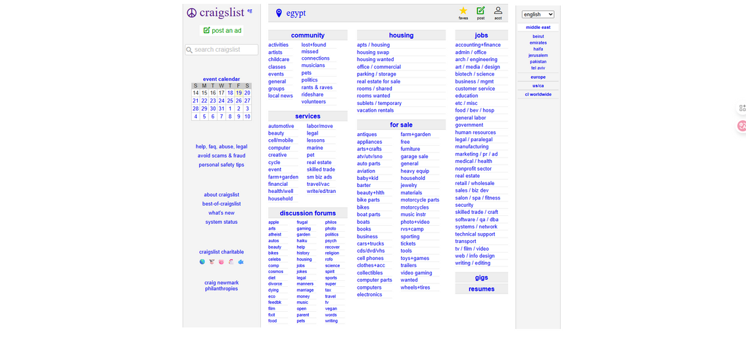
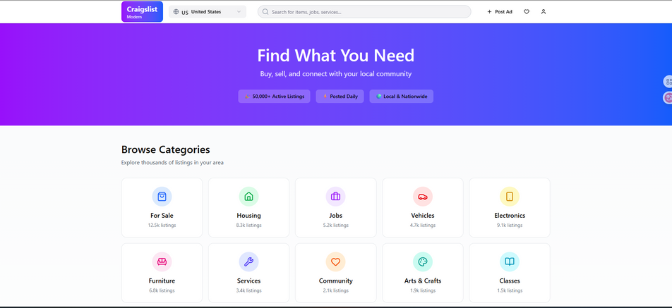
Before vs After
LAYOUT COMPARISON
The old Craigslist interface used a text-heavy layout, making it challenging for users to quickly identify information. The new design leverages card layouts for better organization and clarity.
NAVIGATION SIMPLICITY
Users previously faced complex navigation options that were overwhelming. The redesigned site adopts a simplified navigation structure, allowing users to find what they need with ease and efficiency.

Slide 5
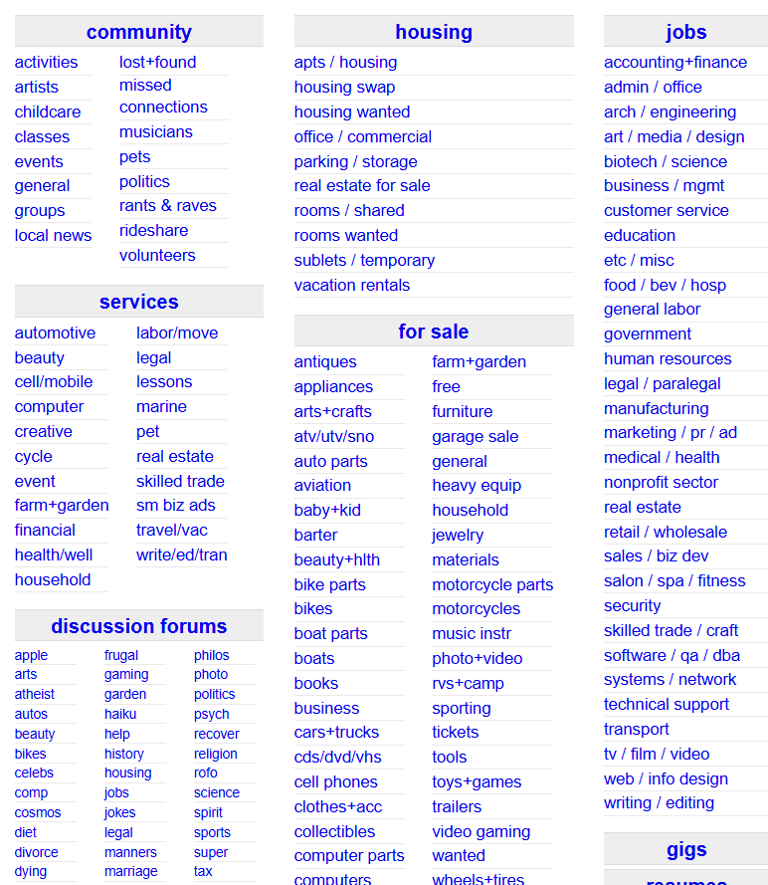
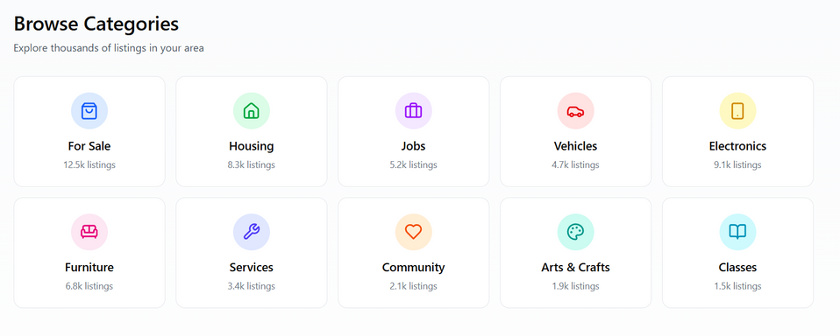
Menu of categories
  old design: Too many options and long text → confusing and slow decisions, hard to use on mobile, better for expert users.
  new design: Fewer options in clear cards → faster understanding, relies on visual recognition, easy on all devices.

Slide 6
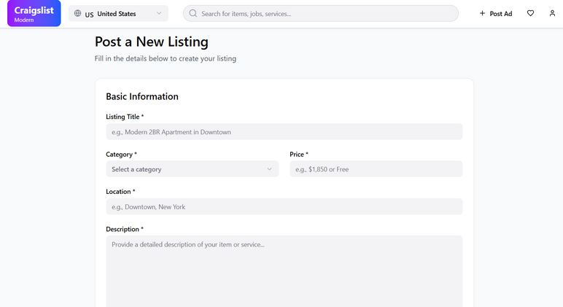
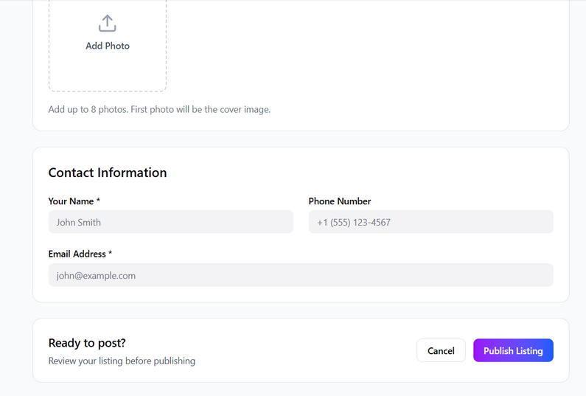
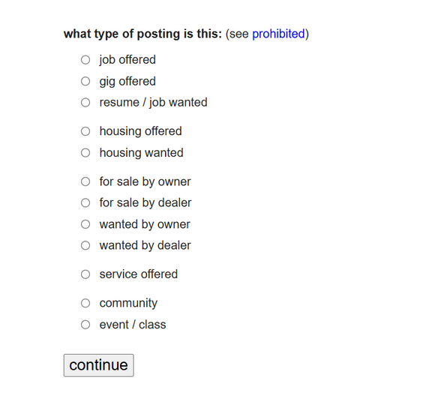
How to add post
  old design: Step-by-step flow with plain text → slower, requires more effort, functional but gives a poor user experience.
  new design: One-page layout with visual guidance → faster, clearer, and easier to use, with a modern and user-friendly design.

Slide 7
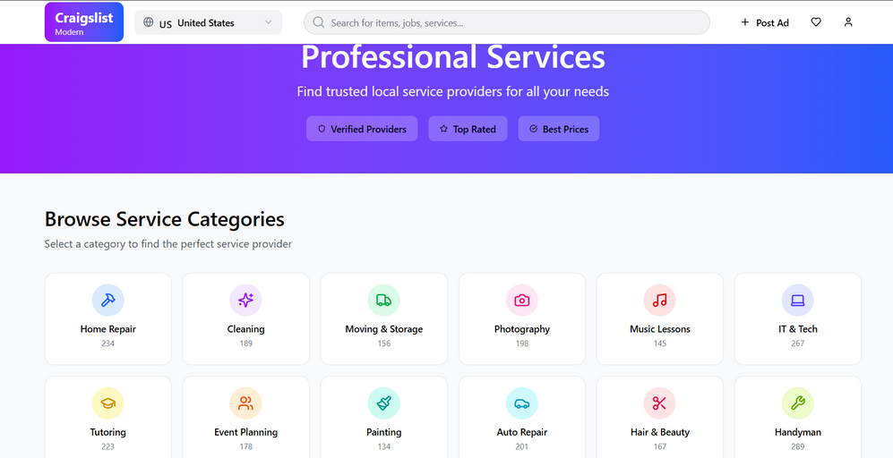
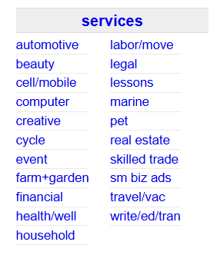
component of categories (services)
  old design: Sequential flow with plain text → slower, requires more effort, functional but poor user experience.
  new design: One-page layout with visual guidance → faster, clearer, and gives users more control with a modern, clean design.

Slide 8
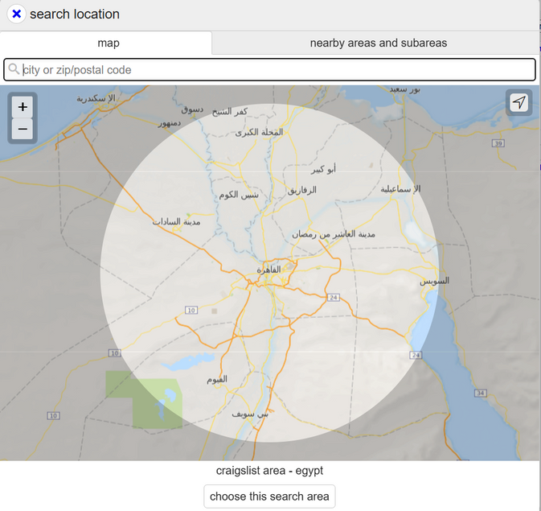
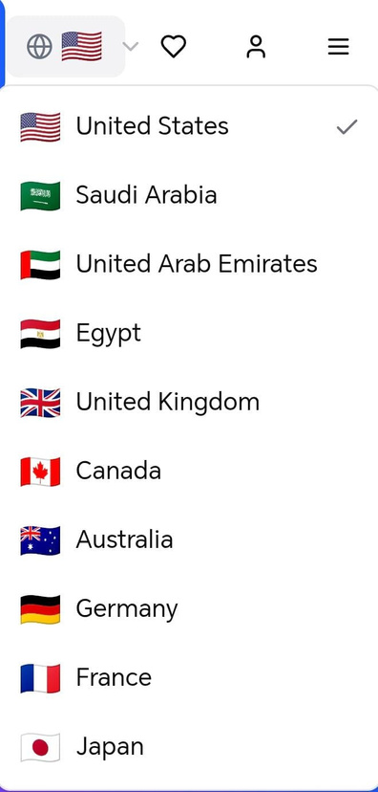
How to select your position
  Old design: "The Functional Approach"
    Interaction: Focuses on Manual Input. The user has to do the heavy lifting by searching, typing, or navigating a complex map.
    Efficiency: It offers high precision but at the cost of speed and ease of use.
    User Effort: High cognitive load; it feels like a "tool" rather than an
    "experience."
  Modern Style: "The Intuitive Approach"
    Interaction: Focuses on Recognition. By using flags and a simple list, the interface reduces the mental effort required to make a choice.
    Usability: Highly optimized for Mobile (Touch). Large buttons and clear icons make it fast and error-free.
    User Effort: Low cognitive load; it prioritizes a "frictionless" experience where the user finds what they need instantly.

Slide 9

Conclusion
The analysis shows how the old design's focus on functionality led to usability issues, while the new design enhances user satisfaction through improved aesthetics and functionality.

Slide 10



